Slide 1





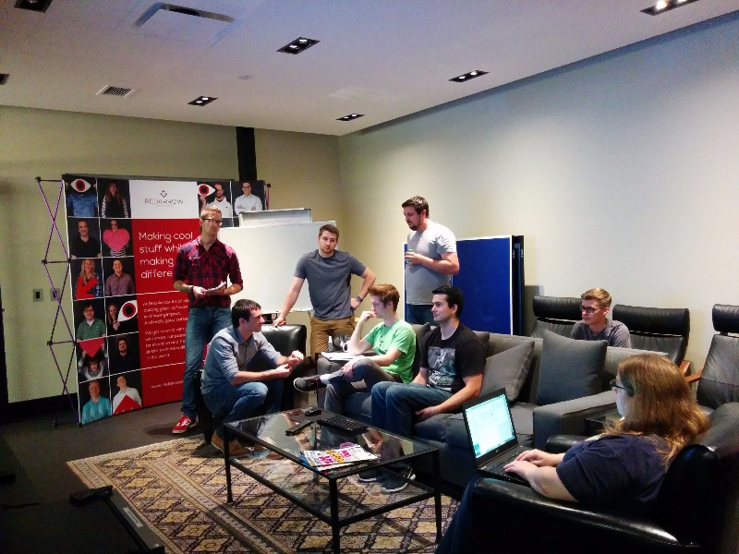

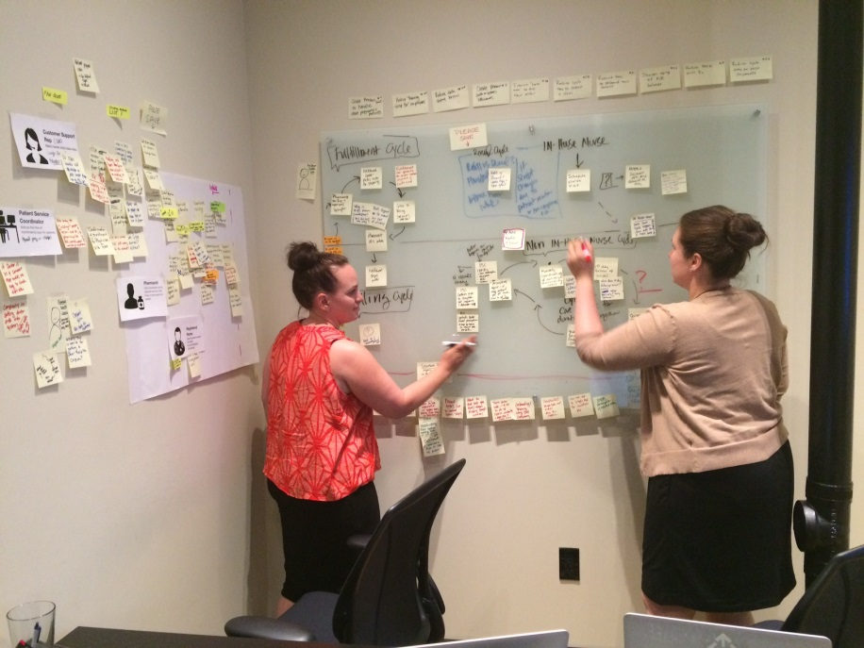






Slide 2
Hiking through the Approval Test Trail Wyatt Webb, Red Arrow Labs

Slide 3


Notes:
Thank the voters

Slide 4


Slide 5


Hiking Down the Approval Test Trail
Unit testing validation
Manual Assert vs. Approval Tests
Testing multiple inputs in one test
.NET Web API Testing
Testing with Approval Tests
Unit testing Razor views
Razor Generator
Testing coverage improvement
Approval Utilities Logger
Questions
Contact Info
@wyattwebb
https://github.com/wyattwebb/ApprovalTestsTalk
http://wyattwebb.com
Introduction
Persistence / View Model Mapping
Unit testing auto projection (mapping)
Manual Asserts vs. Approval Test
What are Approval Tests
How are they used? Why they are useful?
How to install them
Introduction to AutoFixture
Reporters
JSON Reporter
HTML Reporter

Slide 6

Wyatt Webb
Introduction
Milwaukee, WI
15 years of professional development
Red Arrow Labs develops technology solutions for companies who are transforming health.
Notes:
Red Arrow is a Business to Business/ Business to Consumer Custom Software Shop
History of the last 6 years
Purchase by Dohmen
Where we go from here

Slide 7
Participation

Slide 8
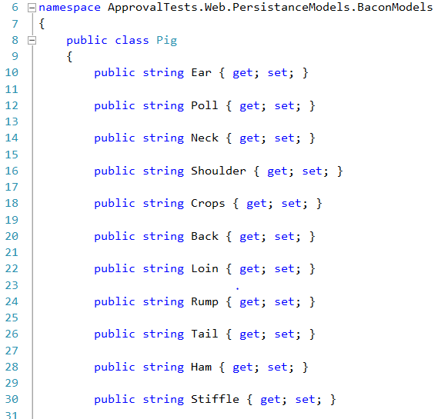
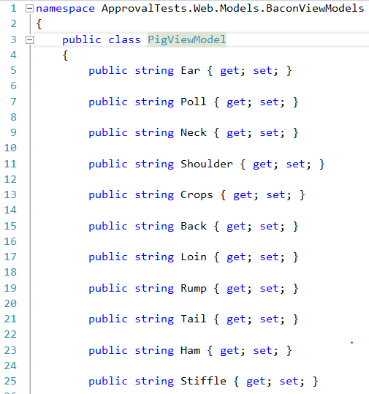
Persistence / View Model Mapping
Unit Testing
Model Separation
Woes of Mapping
To Auto Map or Not
Notes:
ORM’s and data mapping
Why not to expose the persistence models
Mapping code is really gross
Auto maps are not refactor friendly without unit tests.

Slide 9
Code

Slide 10
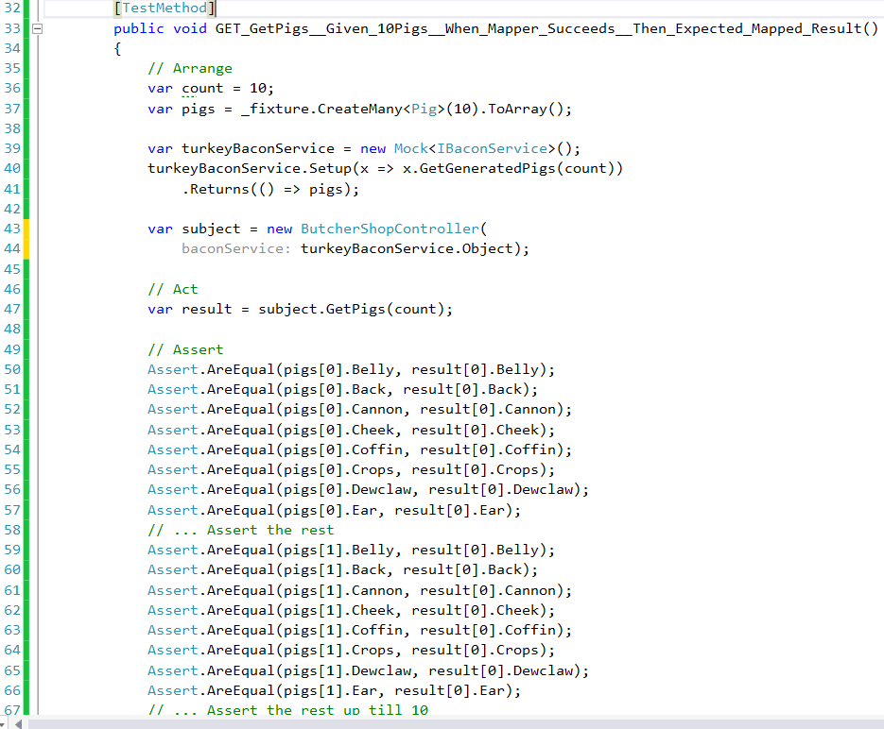
Persistence / View Model Mapping
Unit Testing
Unit Testing Maps
Traditional Asserts
Approval Test

Slide 11
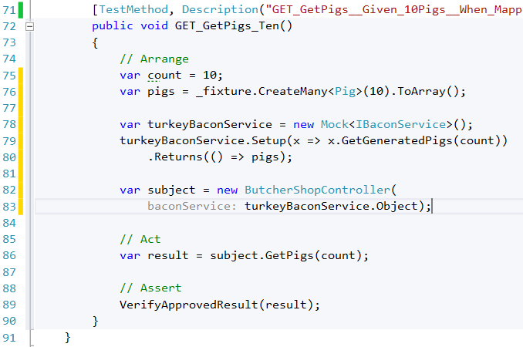
Persistence / View Model Mapping
Unit Testing
Unit Testing Maps
Traditional Asserts
Approval Test

Slide 12


What Are Approval Tests?
Approval Tests
Approval tests simplify unit testing by taking a snapshot of the results, and confirming that they have not changed.
Human knowledge
How are they used
Why are they useful
Notes:
Human knowledge
They required human intelligence for them to work as code is created/refactored
They can replace MANY MANY lines of manual unit test assertions.
They could be used for automated tests to visually inspect results of inputs and outputs.
Makes coding faster and more efficient.

Slide 13
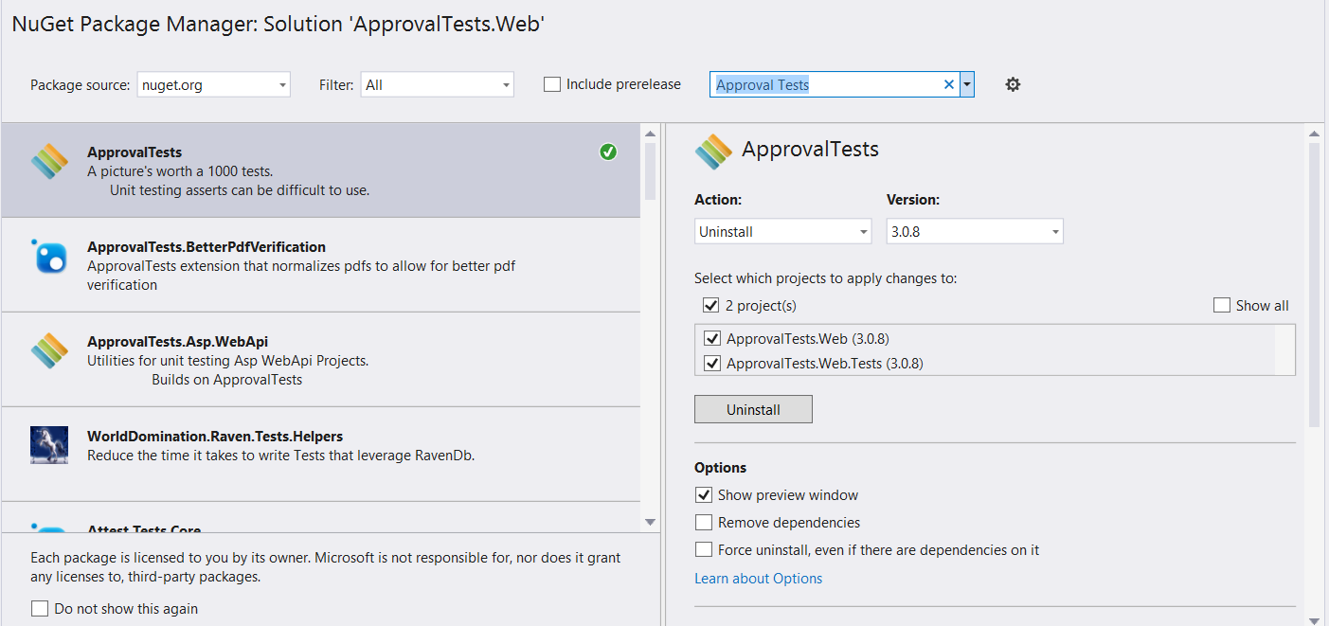
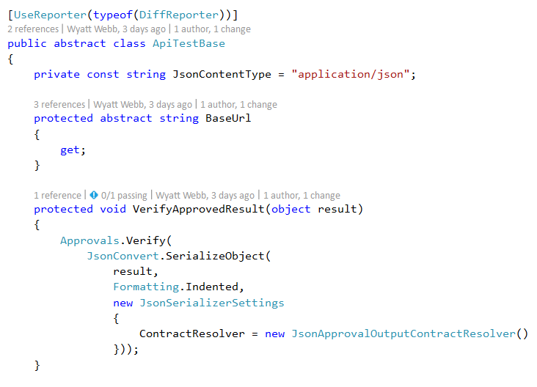
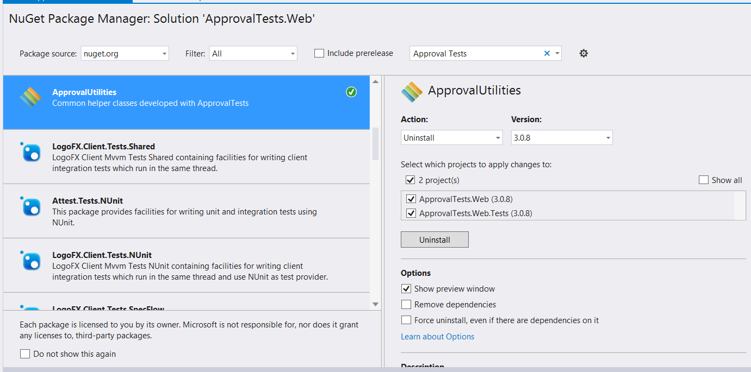
Installation
Approval Tests
via nuGet
NUnit
xUnit.net
MSTest
MBunit

Slide 14
Code

Slide 15

Introduction
AutoFixture
AutoFixture is an open source library for .NET designed to minimize the 'Arrange' phase of your unit tests in order to maximize maintainability.
Traditional Arrange
AutoFixture Arrange
Customize
Gotchas

Slide 16
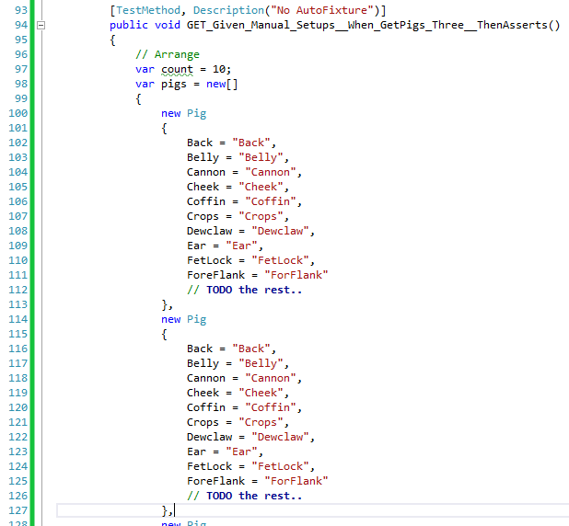
Introduction
AutoFixture
AutoFixture is an open source library for .NET designed to minimize the 'Arrange' phase of your unit tests in order to maximize maintainability.
Traditional Arrange
AutoFixture Arrange
Customize
Gotchas

Slide 17
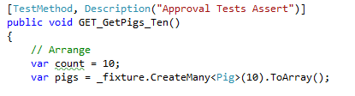
Introduction
AutoFixture
AutoFixture is an open source library for .NET designed to minimize the 'Arrange' phase of your unit tests in order to maximize maintainability.
Traditional Arrange
AutoFixture Arrange
Customize
Gotchas

Slide 18
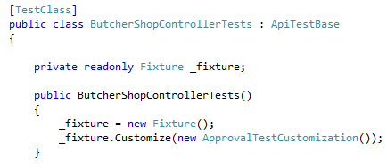
Introduction
AutoFixture
AutoFixture is an open source library for .NET designed to minimize the 'Arrange' phase of your unit tests in order to maximize maintainability.
Traditional Arrange
AutoFixture Arrange
Customize
Gotchas
Notes:
Guids vs Strings
Enumerations
Build vs Create

Slide 19
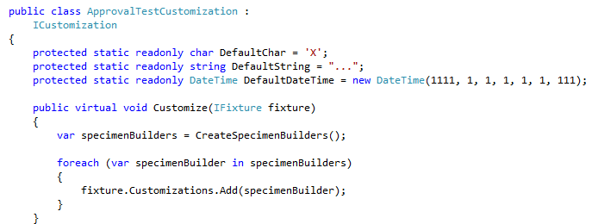
Introduction
AutoFixture
AutoFixture is an open source library for .NET designed to minimize the 'Arrange' phase of your unit tests in order to maximize maintainability.
Traditional Arrange
AutoFixture Arrange
Customize
Gotchas
Notes:
Guids vs Strings
Enumerations
Build vs Create

Slide 20

Introduction
AutoFixture
AutoFixture is an open source library for .NET designed to minimize the 'Arrange' phase of your unit tests in order to maximize maintainability.
Traditional Arrange
AutoFixture Arrange
Customize
Gotchas
Notes:
SQL Column Lengths
Registering dependencies
Shiny new hammer

Slide 21
Code

Slide 22
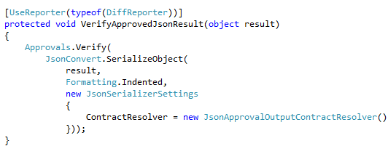
Reporters/Approvers
Approval Tests
DiffReporter
Using JSON Serialization
FileLauncherReporter
Html verification

Slide 23
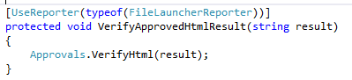
Reporters/Approvers
Approval Tests
DiffReporter
Using JSON Serialization
FileLauncherReporter
Html verification

Slide 24
Code

Slide 25
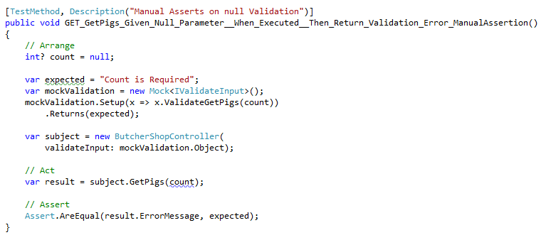
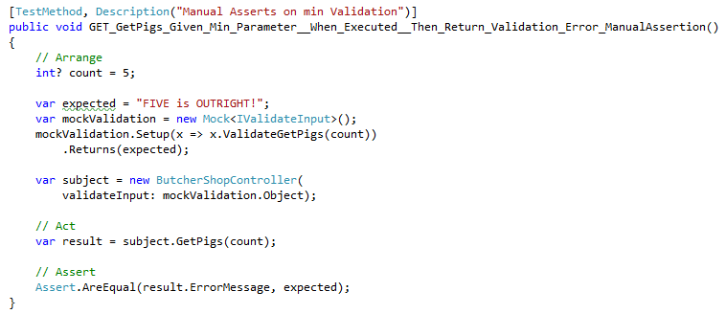
Validation
Unit Testing
Manual Assert
Approval Tests
Multiple Input Scenarios

Slide 26
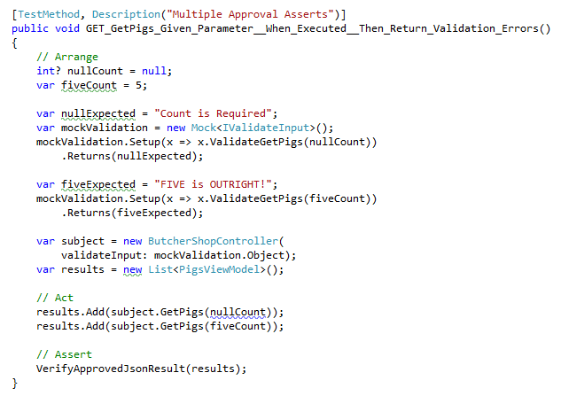
Validation
Unit Testing
Manual Assert
Approval Tests
Multiple Input Scenarios

Slide 27
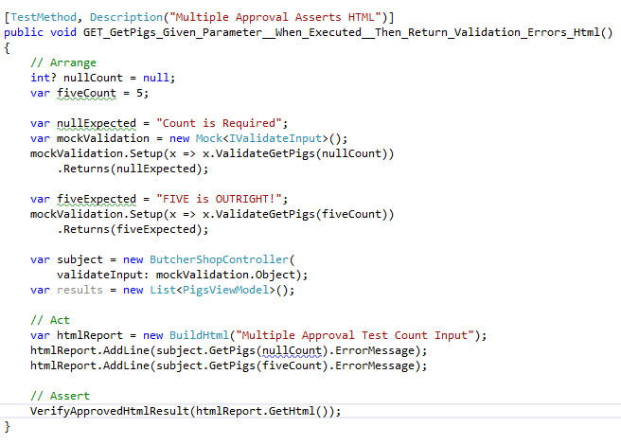
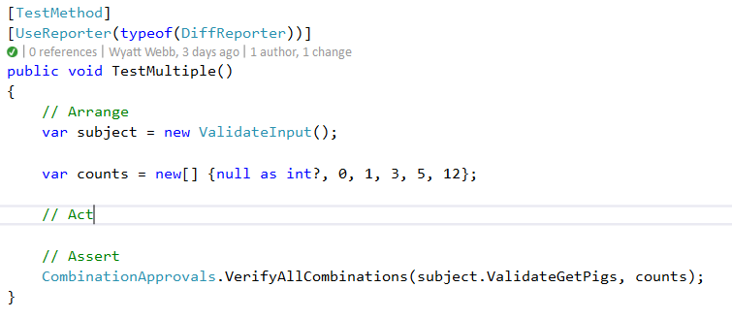
Validation
Unit Testing
Manual Assert
Approval Tests
Multiple Input Scenarios

Slide 28
Code

Slide 29
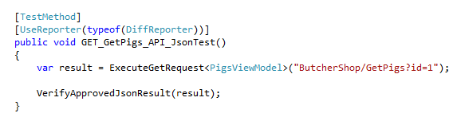
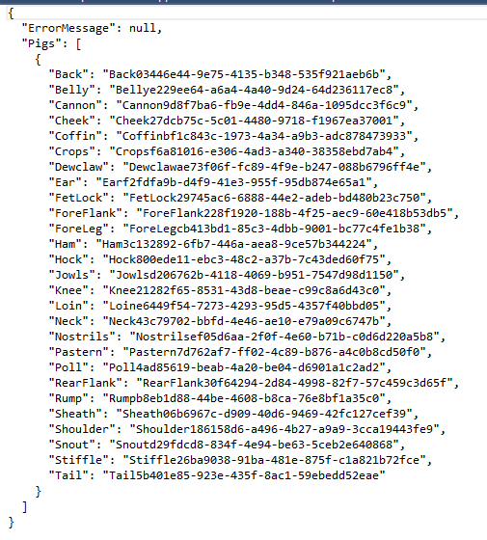
.NET Web API
Unit Testing
Approval Tests

Slide 30
Code

Slide 31
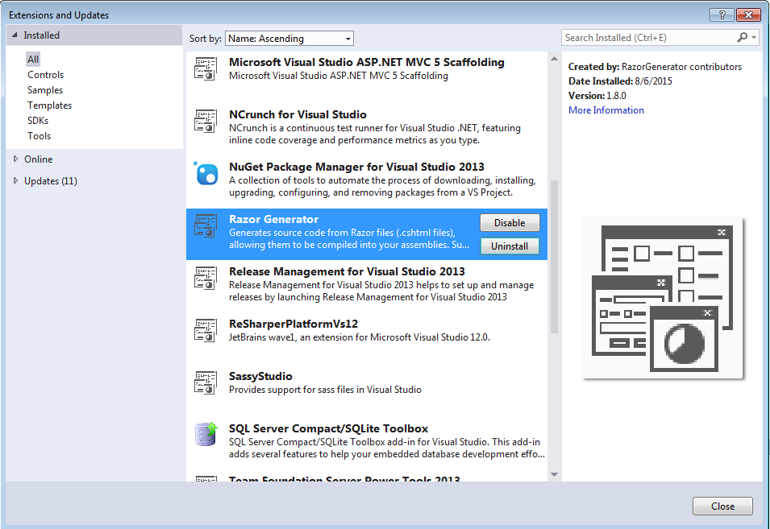
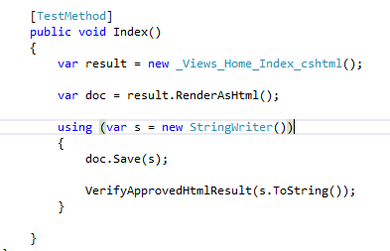
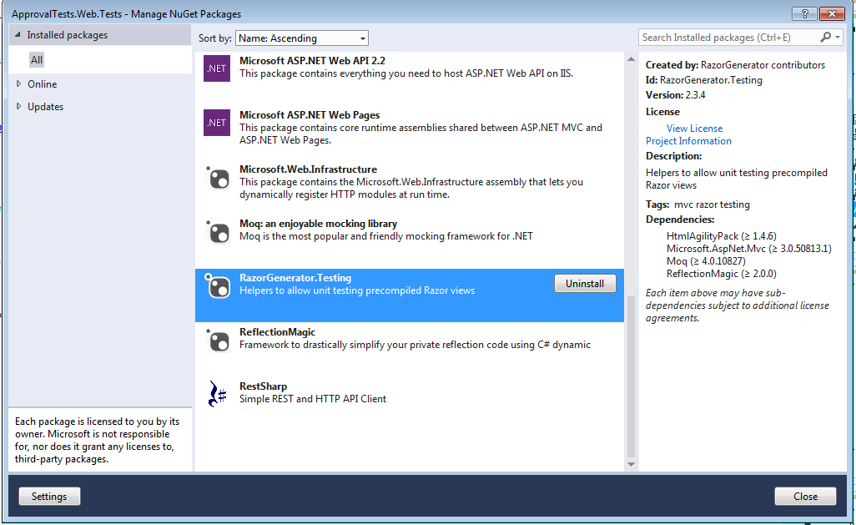
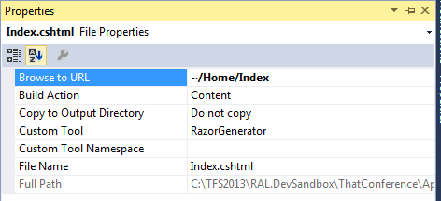
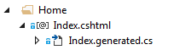
Testing Razor Views
Unit Tests
Razor Generator

Slide 32
Code

Slide 33
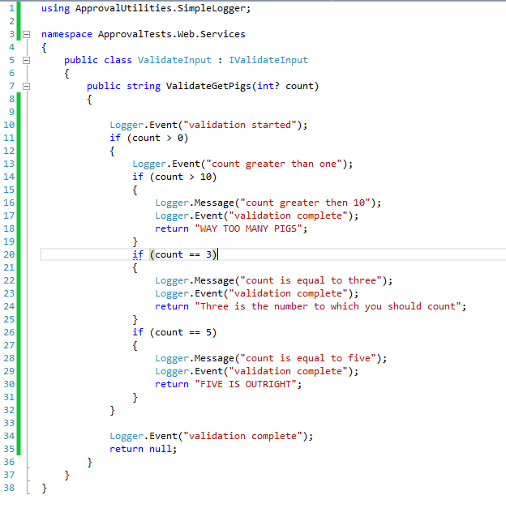
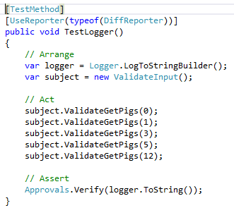
Testing coverage improvement
Unit Tests
Logger

Slide 34
References
References
Approval Tests.Net
Pluralsight
Auto Mapper
Approval Tests.com
Razor Generator
https://github.com/approvals/ApprovalTests.Net
http://www.pluralsight.com/
https://github.com/AutoMapper/AutoMapper
http://approvaltests.com
http://razorgenerator.codeplex.com/

Slide 35
Hiking Down the Approval Test Trail
Introduction
Persistence / View Model Mapping
Unit testing auto projection (mapping)
Manual Asserts vs. Approval Test
What are Approval Tests
How are they used? Why they are useful?
How to install them
Introduction to AutoFixture
Reporters
JSON Reporter
HTML Reporter
Unit testing validation
Manual Assert vs. Approval Tests
Testing multiple inputs in one test
.NET Web API Testing
Testing with Approval Tests
Unit testing Razor views
Razor Generator
Testing coverage improvement
Approval Utilities Logger
Questions
Contact Info
@wyattwebb
http://github.com/wyattwebb/ApprovalTestsTalk
http://wyattwebb.com

Slide 36
QUESTIONS

